Slide 1
Enhancing Data Security: Analysis of Symmetric and Asymmetric Cryptography Algorithms
Presented By Brad Bolluyt, Steven Do, Charles Tran, and Elizabeth Woo

Slide 2
Table of contents
01
02
03
04
05
Symmetric vs. Asymmetric Cryptography
DES (Data Encryption Standard)
AES (Advanced Encryption Standard)
RSA (Rivest-
Shamir-
Adleman)
Results & Conclusion

Slide 3

Executive summary
This benchmarking study evaluates the cryptographic performance of the Nexys A7-100T FPGA (Field-Programmable Gate Array) when implementing three widely used encryption algorithms: AES (Advanced Encryption Standard), RSA (Rivest-Shamir-Adleman), and DES (Data Encryption Standard). The Nexys A7-100T FPGA offers a parallel processing architecture, making it well-suited for cryptographic applications.

Slide 4
01
Symmetric vs. Asymmetric Cryptography

Slide 5
The Differences
Number of keys:
Symmetric - Uses a single shared secret key for both encryption/decryption
Asymmetric - Involves a pair of mathematically related keys: a public key for encryption and a private key for decryption
Complexity:
Symmetric - Generally faster and more computationally efficient
Asymmetric - Involves more complex mathematical operations, making it slower
Uses:
Symmetric - Commonly used for encrypting large amounts of data (e.g., files, messages) due to its efficiency.
Asymmetric - Often used for secure key exchange, digital signatures, and establishing secure communication channels.

Slide 6
02
DES (Data Encryption Standard)

Slide 7
What is DES?
The Data Encryption Standard (DES) is a symmetric key encryption algorithm designed for securing electronic data. Developed by IBM in the 1970s and later standardized by the U.S. National Institute of Standards and Technology (NIST), DES operates on fixed-size blocks of data, typically 64 bits. Its fundamental principle involves the use of a single secret key for both encryption and decryption. DES performs a series of substitution and permutation operations, organized into multiple rounds, to transform plaintext into ciphertext and vice versa. Despite its historical significance, DES is considered a legacy algorithm due to its susceptibility to brute-force attacks with modern computing power. It has been largely replaced by more secure encryption standards like AES.

Slide 8
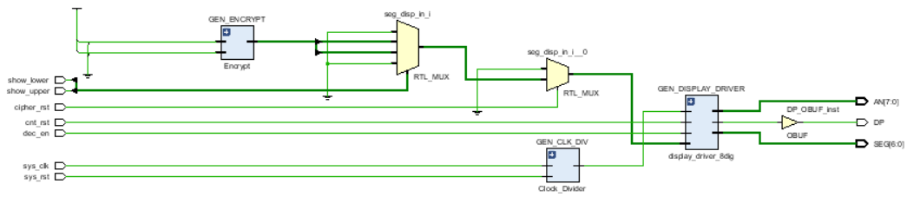
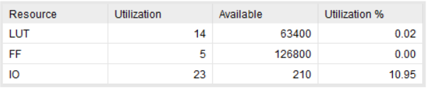
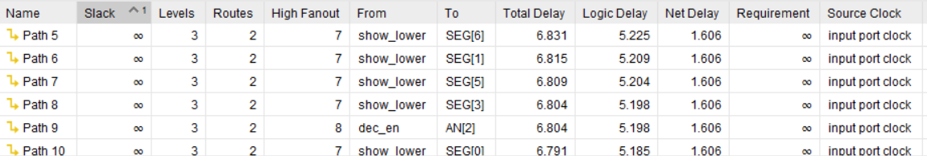
DES Synthesis on Board
This DES implementation uses a low amount of resources on the board
The highest delay through this program is 6.831ns. This means the maximum frequency is around 1/6.831ns ≈ 146.39 MHz

Slide 9
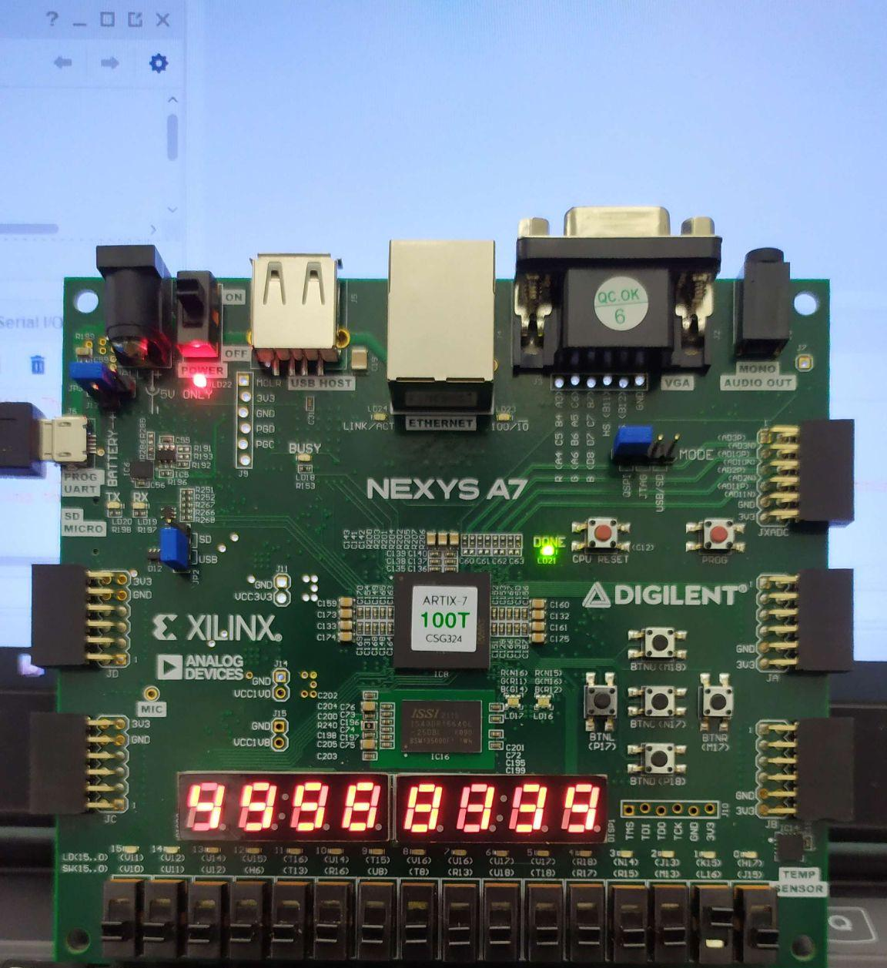
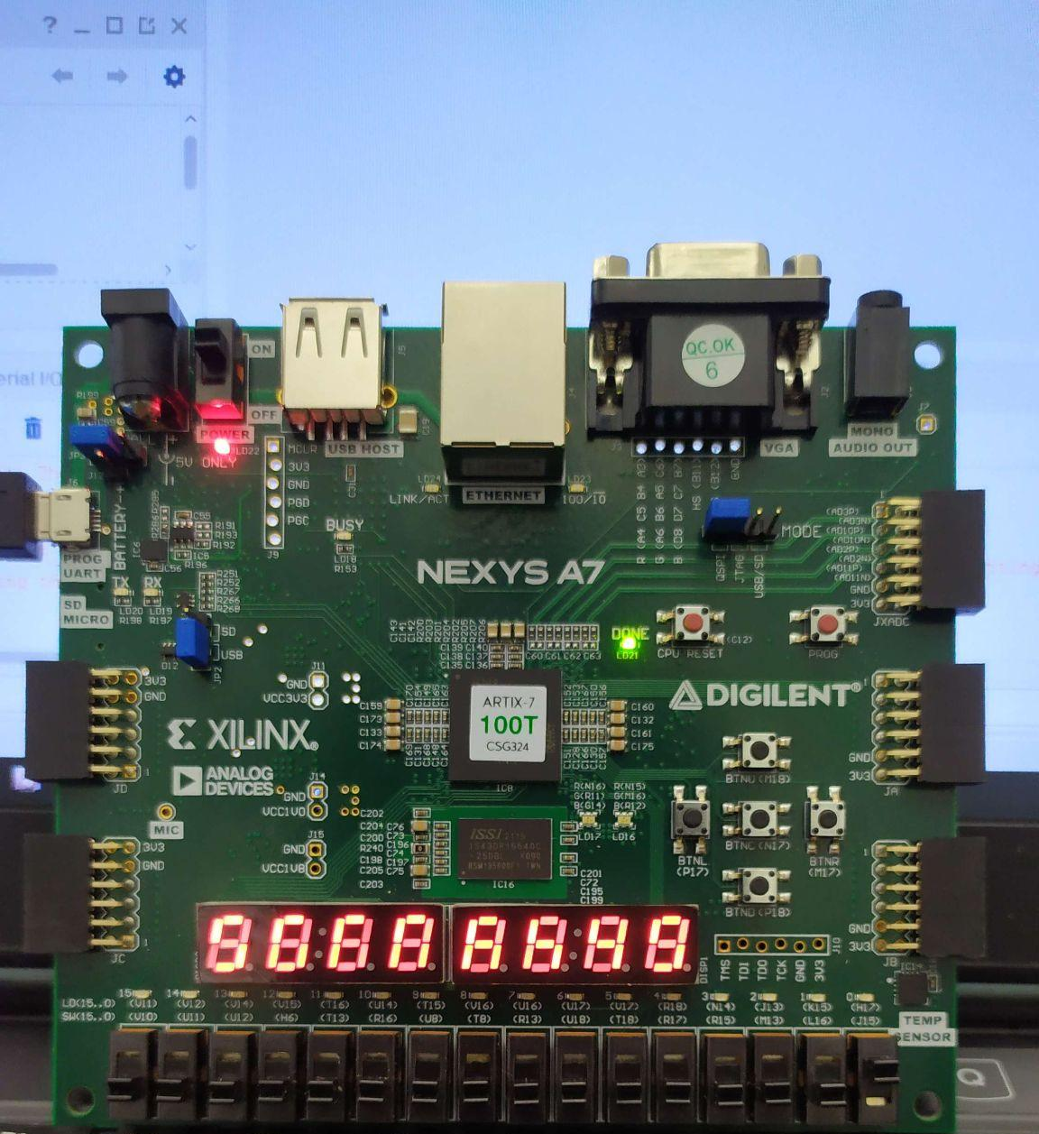
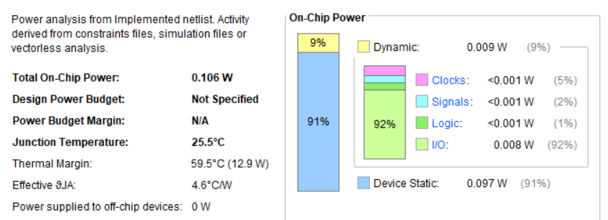
DES Implementation on Board
For the implementation the amount of resources remained the same as the synthesis
The amount of power used was shown to be 0.106W,
Upper 32 bits of Ciphertext
Lower 32 bits of Ciphertext

Slide 10
03
AES (Advanced Encryption Standard)

Slide 11
What is AES?
AES, or Advanced Encryption Standard, is a widely used symmetric encryption algorithm designed to secure sensitive information. It was established as a standard by the National Institute of Standards and Technology (NIST) in 2001. AES operates on fixed-size blocks of data and supports key sizes of 128, 192, or 256 bits.
The algorithm employs a series of substitution, permutation, and mixing operations, organized into multiple rounds, to transform plaintext data into ciphertext. AES is known for its strength and efficiency, making it a cornerstone in securing data for a variety of applications, including securing communications over the internet, encrypting files, and protecting sensitive information in various computing environments. The algorithm's security is attributed to its resistance against known cryptographic attacks and its widespread adoption in various industries.

Slide 12
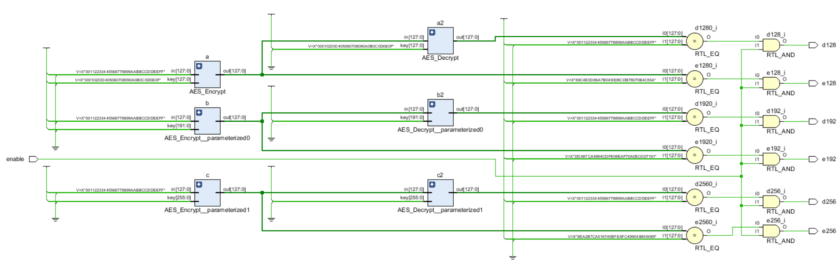
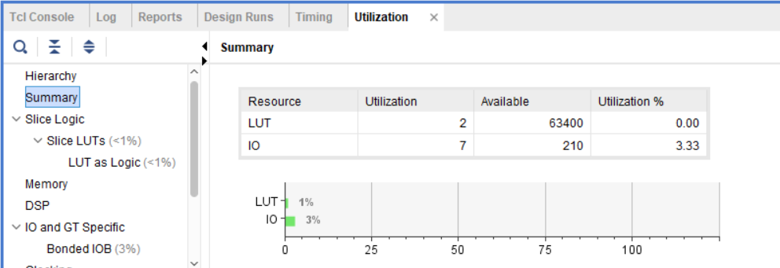
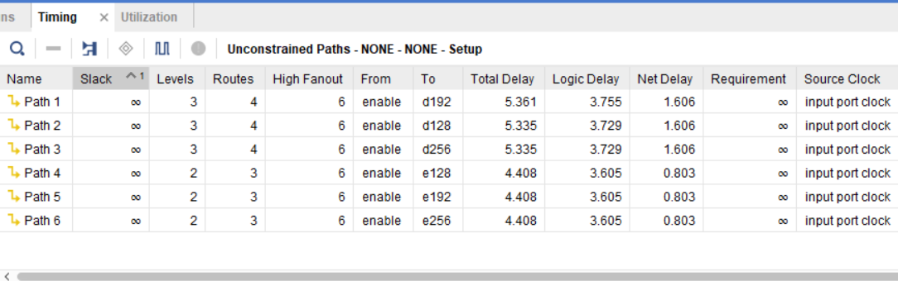
AES Synthesis on Board
This AES implementation uses a very low amount of LUTs and IOs. It is very lightweight in comparison to the previous DES implementation.
The highest delay through this program is 5.361ns. This means the maximum frequency is around 1/5.361ns ≈ 186.53 MHz

Slide 13
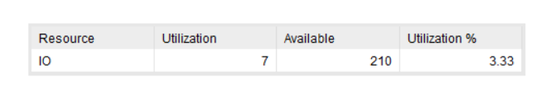
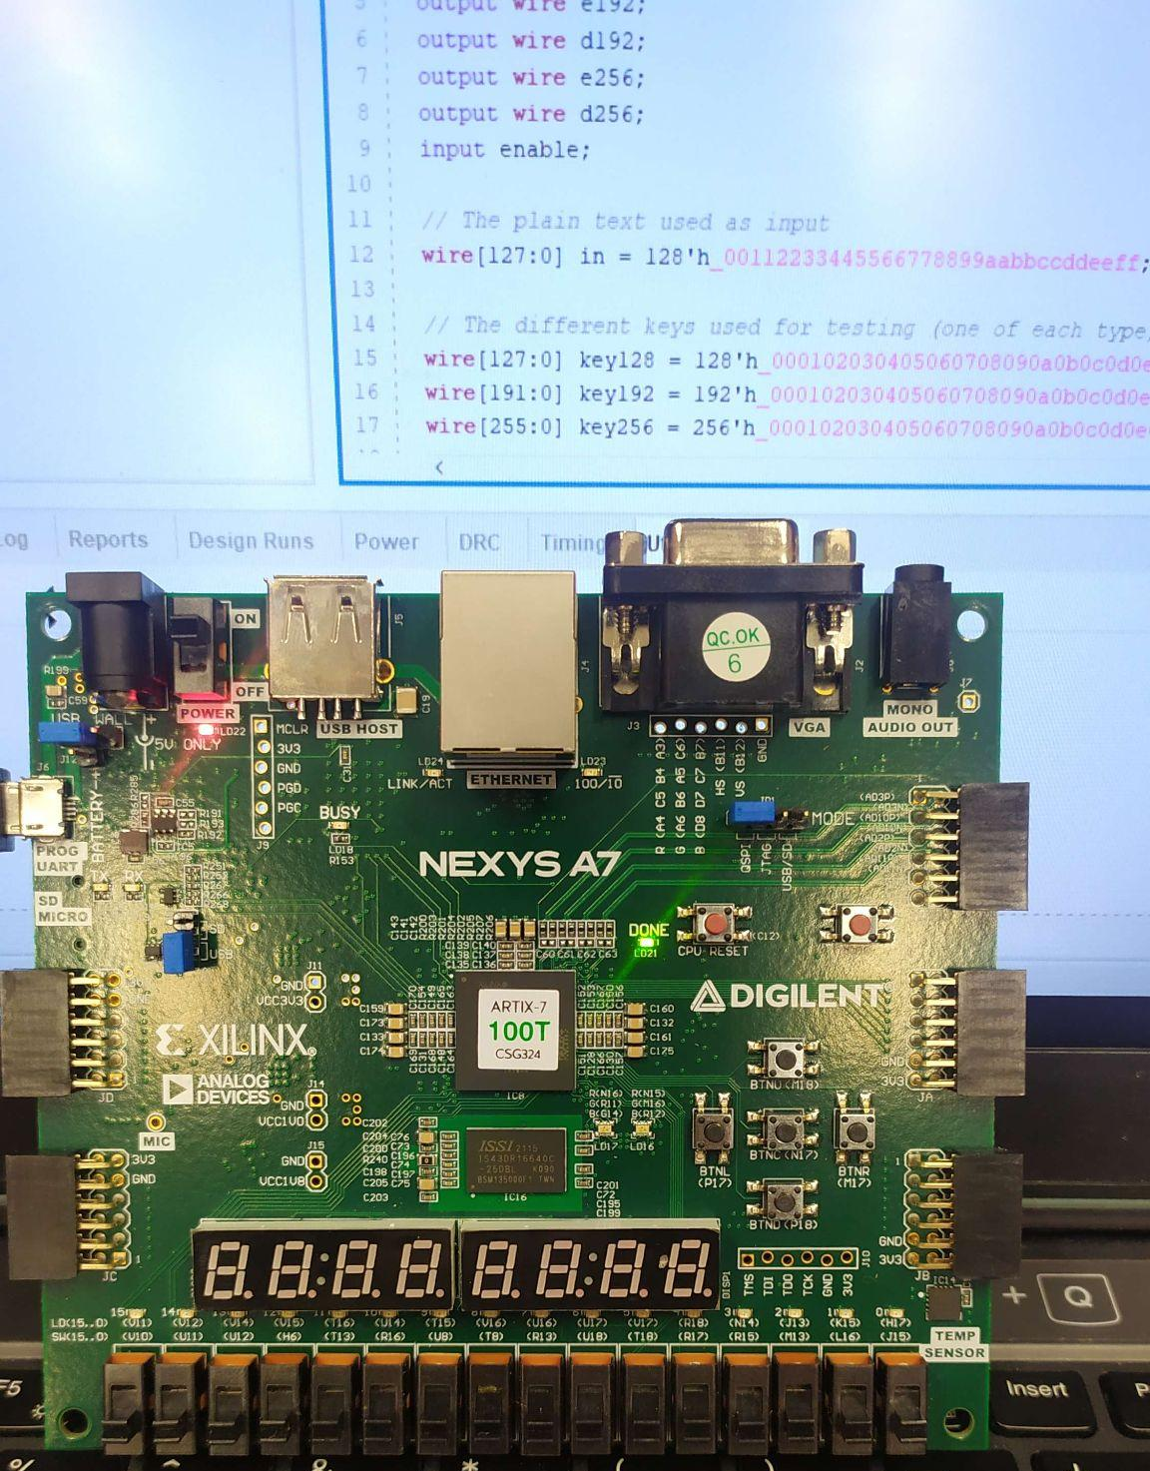
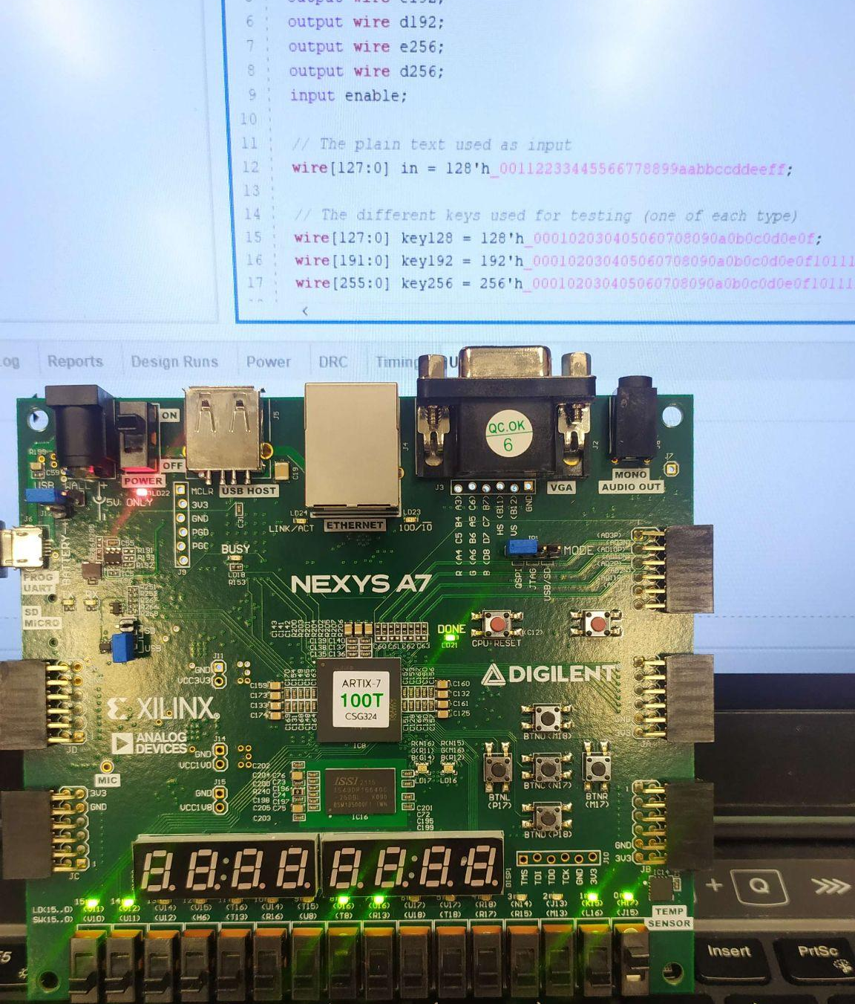
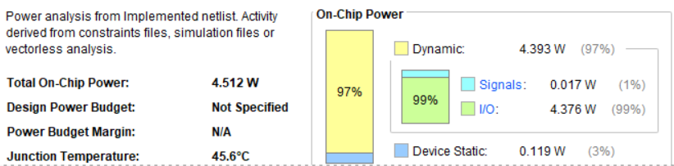
AES Implementation on Board
For the implementation the amount of LUTs went down to 0
The amount of power used was shown to be 4.512W, mainly from the 7 I/O ports that were used
AES Enable Off
AES Enable On

Slide 14
04
RSA (Rivest-Shamir
-Adleman)

Slide 15
What is RSA?
RSA, named after its inventors Rivest, Shamir, and Adleman, is an asymmetric encryption algorithm widely employed for secure communication and digital signatures. In RSA, a pair of keys is generated—a public key for encryption and a private key for decryption. The security of RSA hinges on the challenge of factoring the product of two large prime numbers, forming the basis for its robust encryption. Users can encrypt data using the recipient's public key, and only the recipient, possessing the corresponding private key, can decrypt the message. Moreover, RSA's digital signature capabilities ensure data authenticity and integrity, with the sender using their private key to create a signature that anyone can verify using the sender's public key.

Slide 16
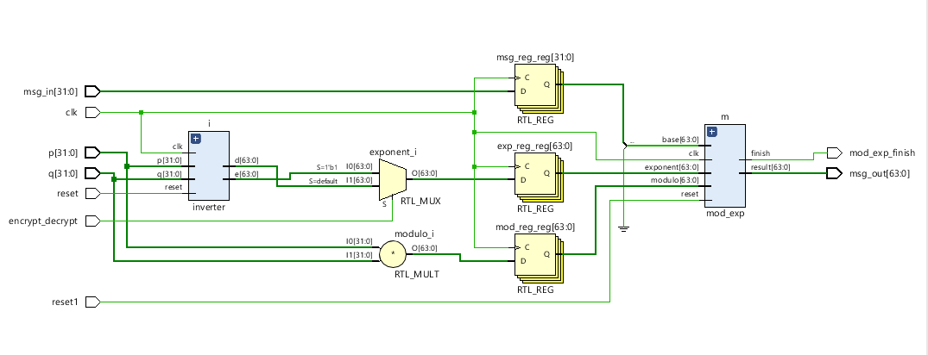
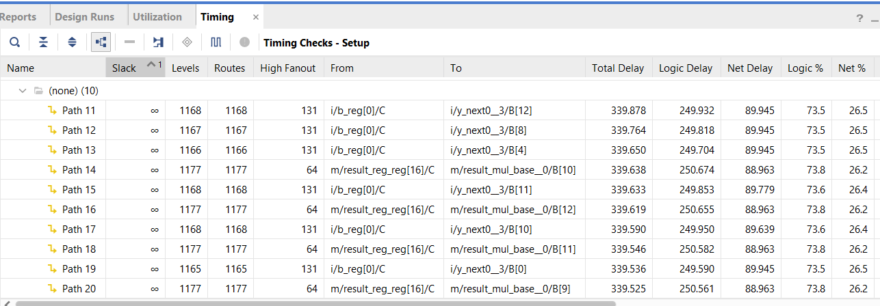
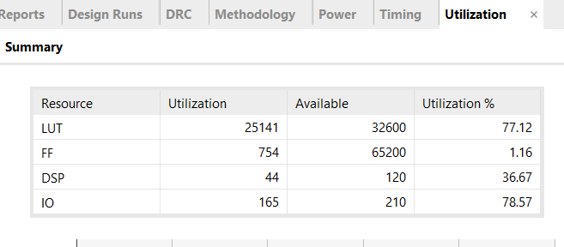
RSA Synthesis on Board
This RSA implementation is far more resource intensive than either of symmetrical encryption algorithms in terms of LUTs, FFs, and DSPs
The highest delay through this program is 339.878ns. This means the maximum frequency is around 1/339.878ns ≈ 2.94 MHz

Slide 17
05
Results & Conclusions

Slide 18
So overall…
The RSA verilog code was intended for user input. Attempting to create a wrapper for the RSA algorithm proved to be difficult so the synthesized results were used for benchmarking instead
Based off these results, we can see that AES is an improvement to DES in terms of resource usage. Additionally, the AES algorithm has a smaller maximum path in comparison to the DES algorithm
Overall, both DES and AES algorithms had similar maximum frequencies (approximately 146 MHz and 187 MHz respectively), while the RSA algorithm had a much slower maximum frequency in comparison to them (approximately 3 MHz)
These results provide a good insight on the structural design of symmetric and asymmetric cryptographic algorithms and provide numerical evidence of both the complexity and speeds of both types of systems where symmetric algorithms generally use less LUTs, FFs, and etc. and have faster speeds, and asymmetric algorithms use more LUTs, FFs, and etc, and have slower speeds

Slide 19
Resources
DES Verilog Code:
https://github.com/jpszczolowski/des-verilog
AES Verilog Code:
https://github.com/michaelehab/AES-Verilog
RSA Verilog Code:
https://github.com/Rajandeep/RSA-CRYPTOSYSTEM-using-verilog

